Slide 1

Chapter 28
Security
Objectives
Upon completion you will be able to:
Differentiate between two categories of cryptography schemes
Understand four aspects of security
Understand the concept of digital signature
Understand the role of key management in entity authentication
Know how and where IPSec, TLS, and PPG provide security

Slide 2
28.1 CRYPTOGRAPHY
The word cryptography in Greek means “secret writing.” The term today refers to the science and art of transforming messages to make them secure and immune to attacks.
The topics discussed in this section include:
Symmetric-Key Cryptography
Asymmetric-Key Cryptography
Comparison

Slide 3
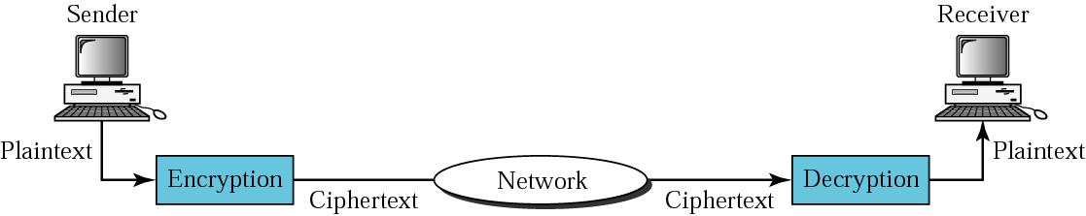
Figure 28.1 Cryptography components

Slide 4

Note:
In cryptography, the encryption/decryption algorithms are public; the keys are secret.

Slide 5
Note:
In symmetric-key cryptography, the same key is used by the sender (for encryption) and the receiver (for decryption). The key is shared.

Slide 6
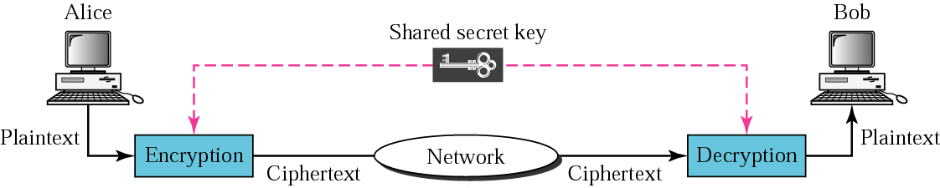
Figure 28.2 Symmetric-key cryptography

Slide 7
Note:
In symmetric-key cryptography, the same key is used in both directions.

Slide 8
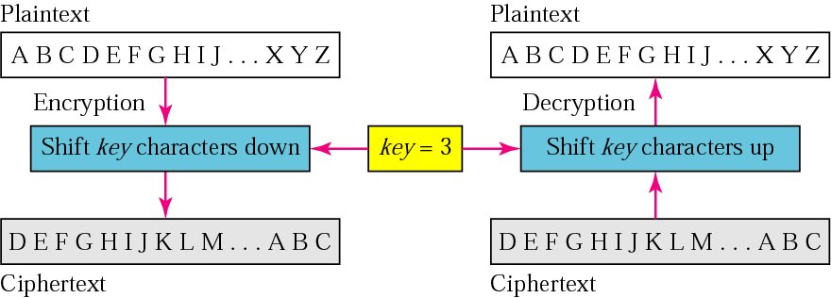
Figure 28.3 Caesar cipher

Slide 9
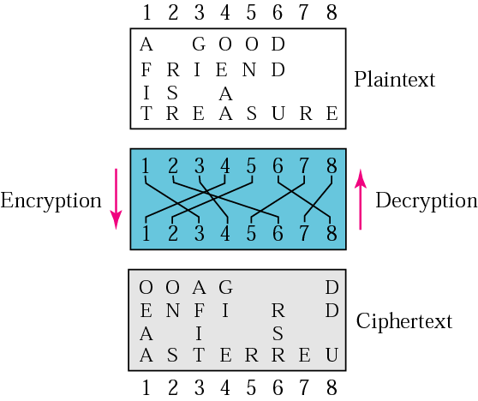
Figure 28.4 Transpositional cipher

Slide 10
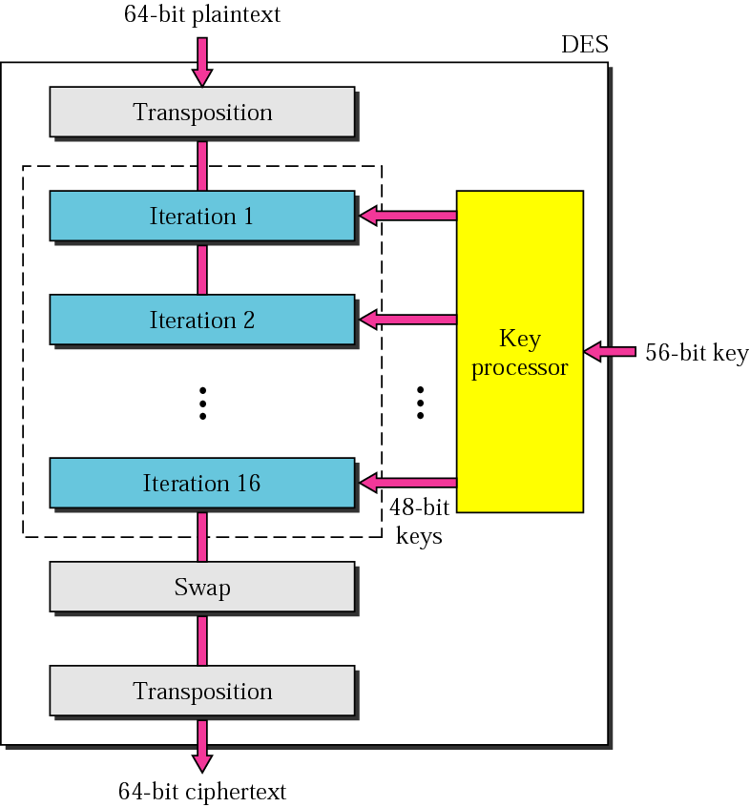
Figure 28.5 DES

Slide 11
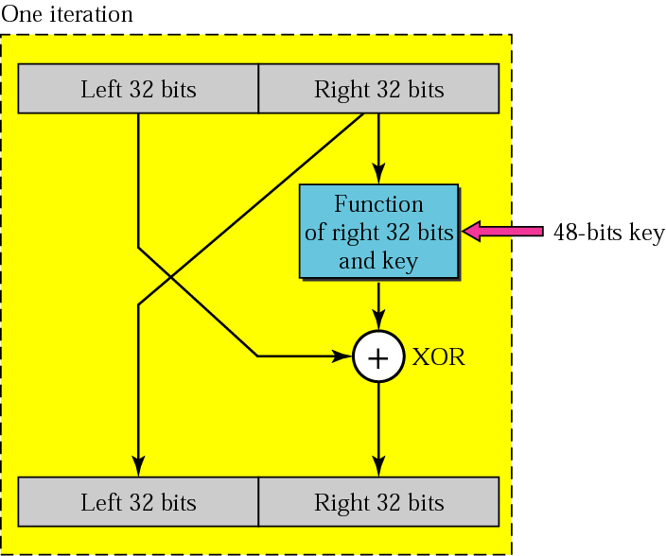
Figure 28.6 Iteration block

Slide 12
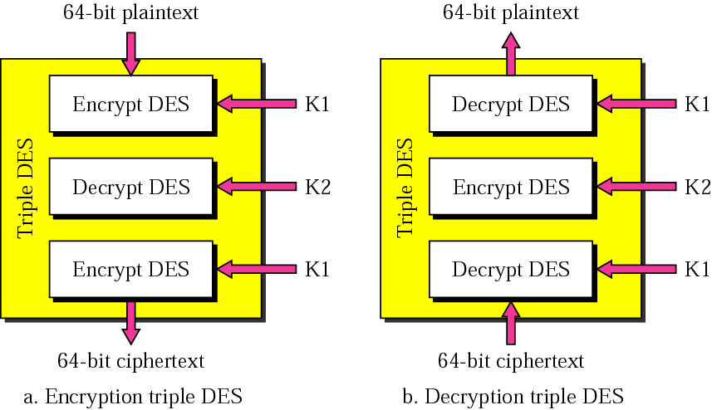
Figure 28.7 Triple DES

Slide 13
Note:
The DES cipher uses the same concept as the Caesar cipher, but the encryption/ decryption algorithm is much more complex.

Slide 14
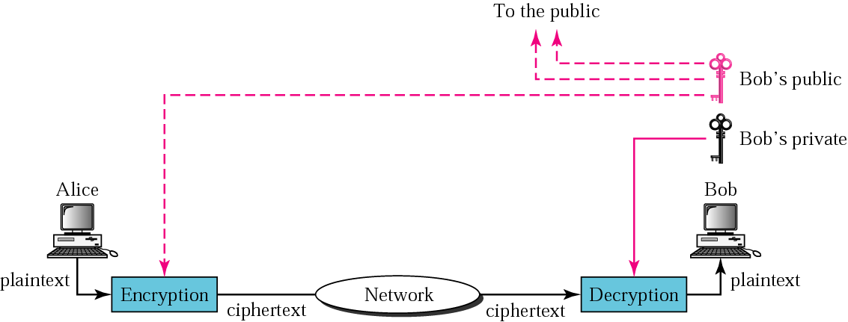
Figure 28.8 Public-key cryptography

Slide 15
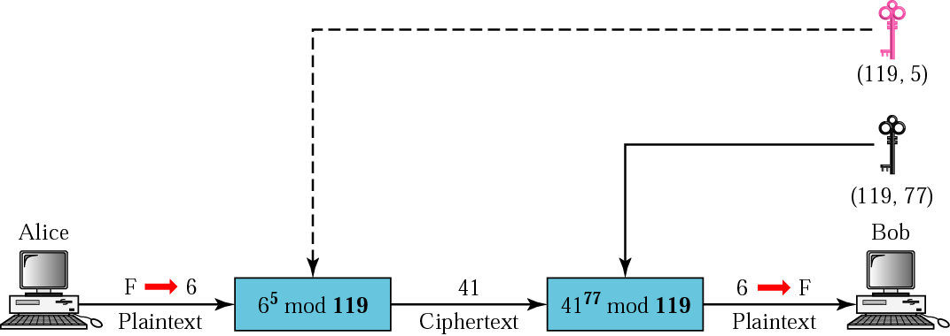
Figure 28.9 RSA

Slide 16
Note:
Symmetric-key cryptography is often used for long messages.

Slide 17
Note:
Asymmetric-key algorithms are more efficient for short messages.

Slide 18
28.2 PRIVACY
Privacy means that the sender and the receiver expect confidentiality. The transmitted message must make sense to only the intended receiver. To all others, the message must be unintelligible.
The topics discussed in this section include:
Privacy with Symmetric-Key Cryptography
Privacy with Asymmetric-Key Cryptography

Slide 19
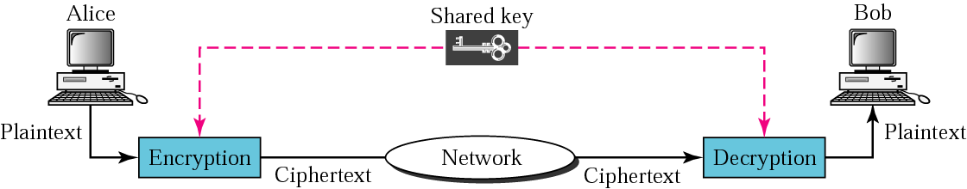
Figure 28.10 Privacy using symmetric-key encryption

Slide 20

Figure 28.11 Privacy using asymmetric-key encryption

Slide 21
Note:
Digital signature can provide authentication, integrity, and nonrepudiation for a message.

Slide 22
28.3 DIGITAL SIGNATURE
Digital signature can provide authentication, integrity, and nonrepudiation for a message.
The topics discussed in this section include:
Signing the Whole Document
Signing the Digest

Slide 23
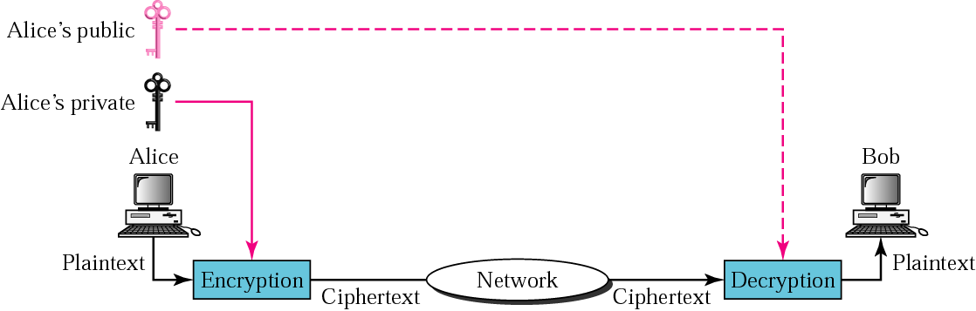
Figure 28.12 Signing the whole document

Slide 24
Note:
Digital signature does not provide privacy. If there is a need for privacy, another layer of encryption/decryption must be applied.

Slide 25
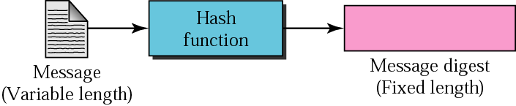
Figure 28.13 Hash function

Slide 26
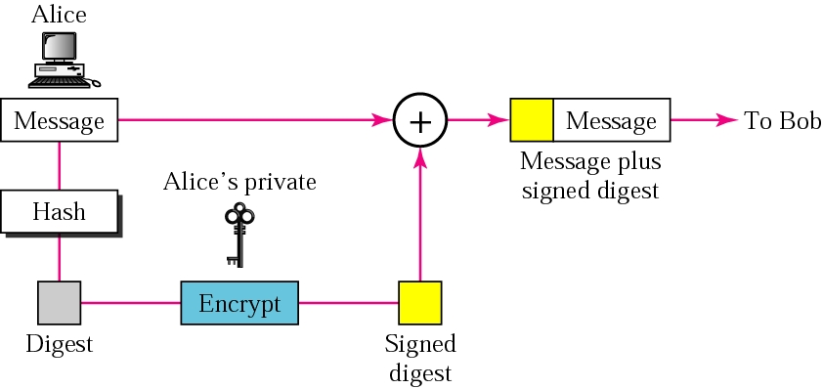
Figure 28.14 Sender site

Slide 27
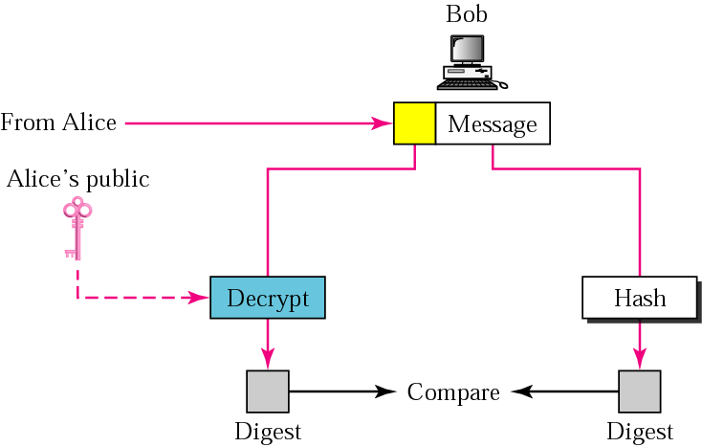
Figure 28.15 Receiver site

Slide 28
28.4 ENTITY AUTHENTICATION
Entity authentication is a procedure that verifies the identity of one entity for another. An entity can be a person, a process, a client, or a server. In entity authentication, the identity is verified once for the entire duration of system access.
The topics discussed in this section include:
Entity Authentication with Symmetric-Key Cryptography
Entity Authentication with Asymmetric-Key Cryptography

Slide 29
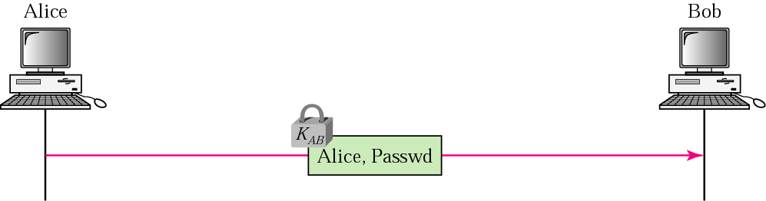
Figure 28.16 Using a symmetric key only

Slide 30
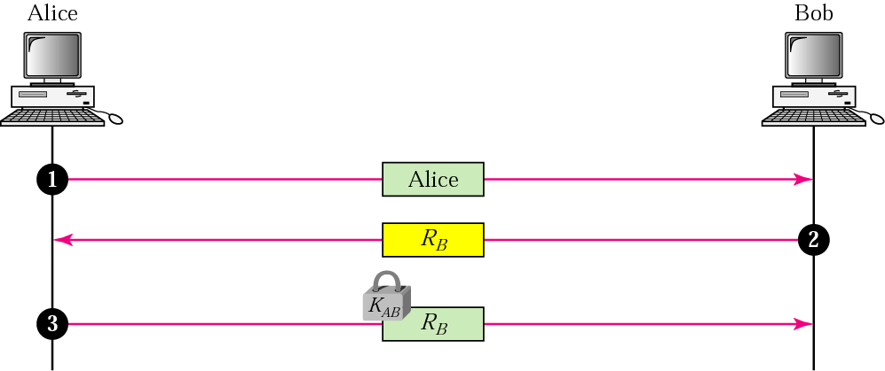
Figure 28.17 Using a nonce

Slide 31
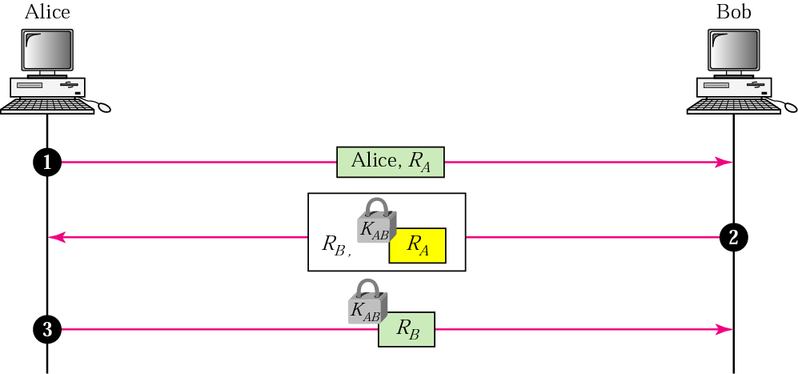
Figure 28.18 Bidirectional authentication

Slide 32
28.5 KEY MANAGEMENT
In this section we explain how symmetric keys are distributed and how public keys are certified.
The topics discussed in this section include:
Symmetric-Key Distribution
Public-Key Certification
Kerberos

Slide 33
Note:
A symmetric key between two parties is useful if it is used only once; it must be created for one session and destroyed when the session is over.

Slide 34
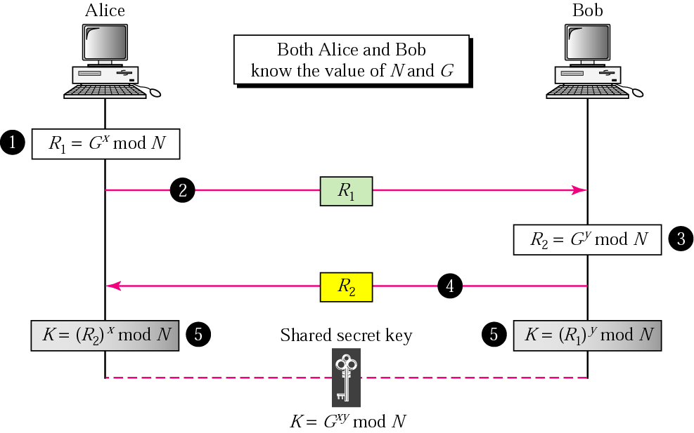
Figure 28.19 Diffie-Hellman method

Slide 35
Note:
The symmetric (shared) key in the Diffie-Hellman protocol is
K = G ^{xy} mod N.

Slide 36
Example 1
Let us give an example to make the procedure clear. Our example uses small numbers, but note that in a real situation, the numbers are very large. Assume G = 7 and N = 23. The steps are as follows:
1. Alice chooses x = 3 and calculates R1 = 7³ mod 23 = 21.
2. Alice sends the number 21 to Bob.
3. Bob chooses y = 6 and calculates R2 = 7⁶ mod 23 = 4.
4. Bob sends the number 4 to Alice.
5. Alice calculates the symmetric key K = 4³ mod 23 = 18.
6. Bob calculates the symmetric key K = 21⁶ mod 23 = 18.
The value of K is the same for both Alice and Bob; G ^{xy} mod N = 7¹⁸ mod 23
= 18.

Slide 37
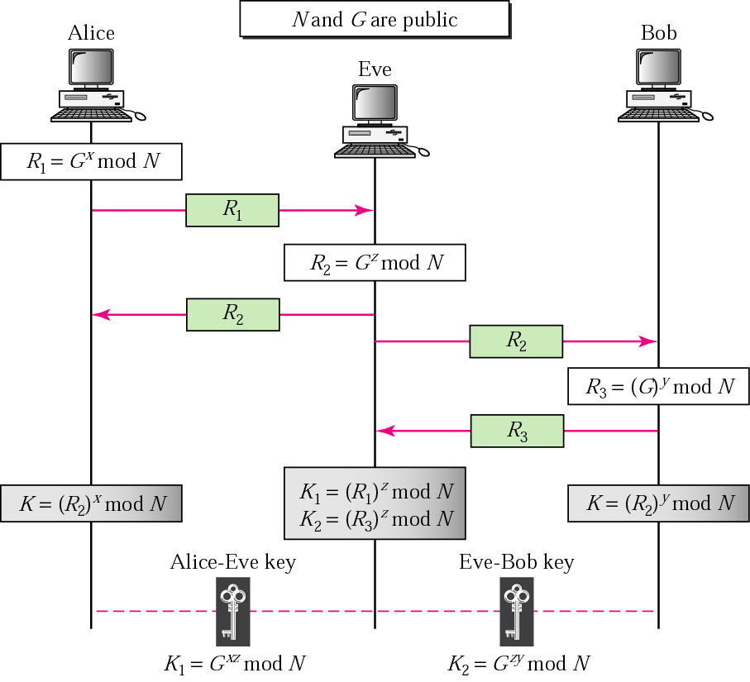
Figure 28.20 Man-in-the-middle attack

Slide 38
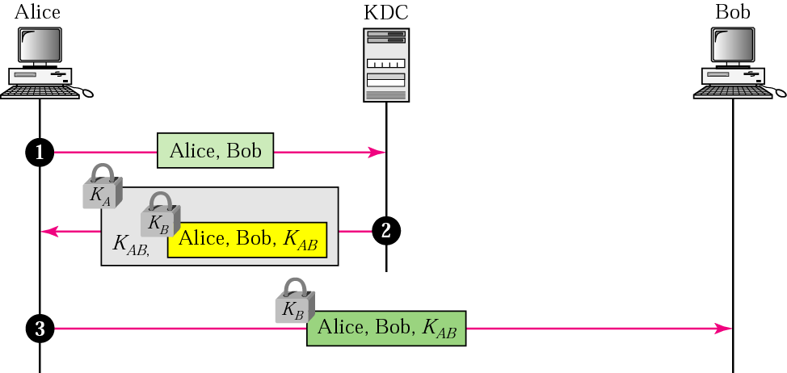
Figure 28.21 First approach using KDC

Slide 39
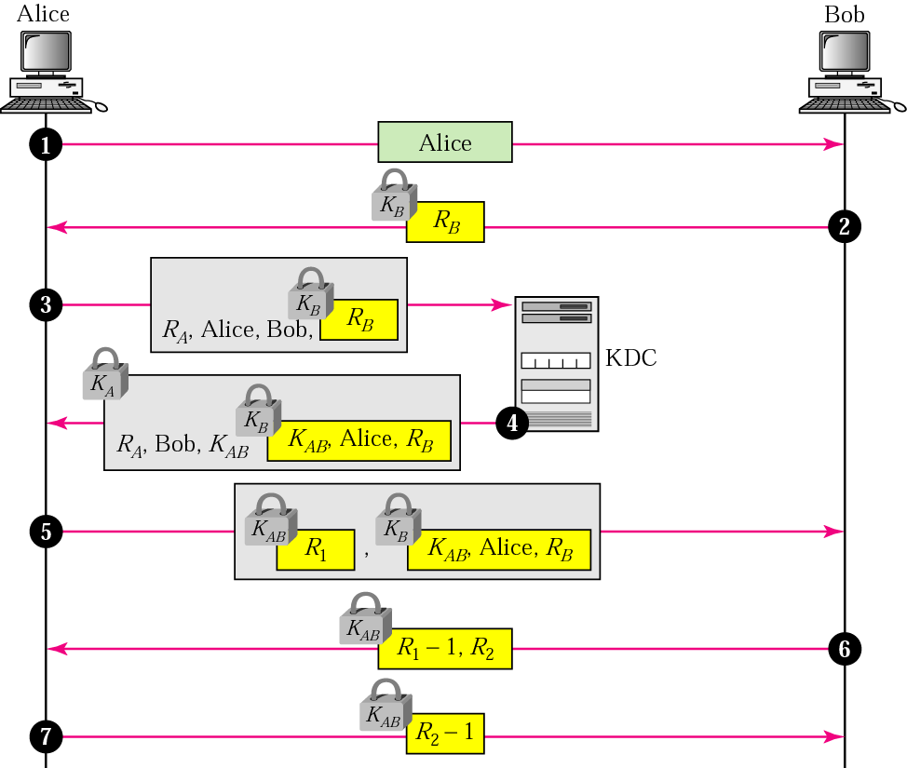
Figure 28.22 Needham-Schroeder protocol

Slide 40
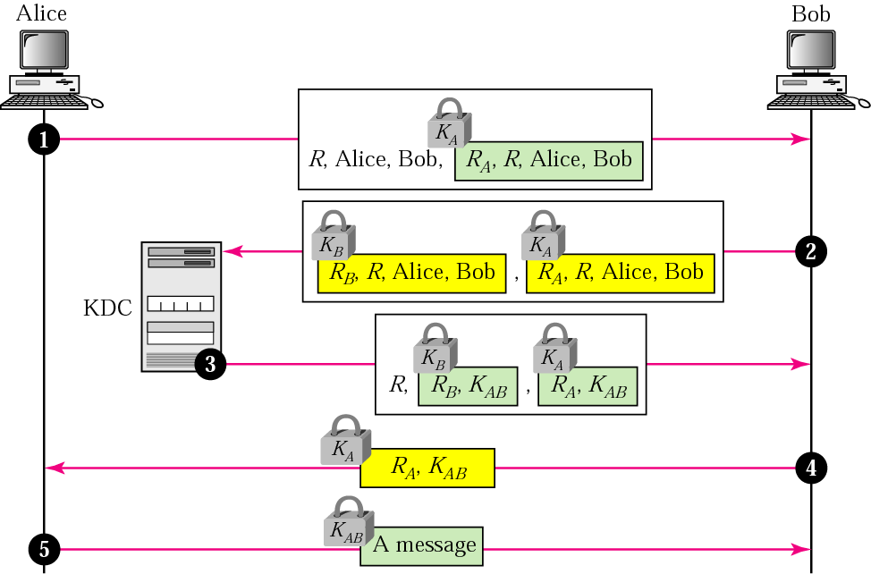
Figure 28.23 Otway-Rees protocol

Slide 41
Note:
In public-key cryptography, everyone has access to everyone’s public key.

Slide 42
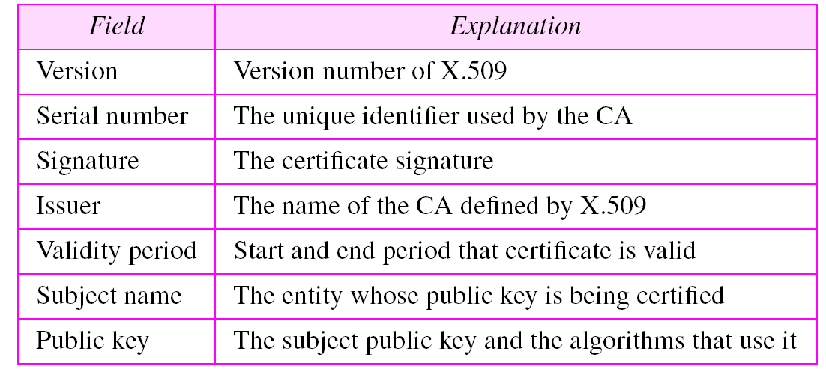
Table 28.1 X.509 fields

Slide 43
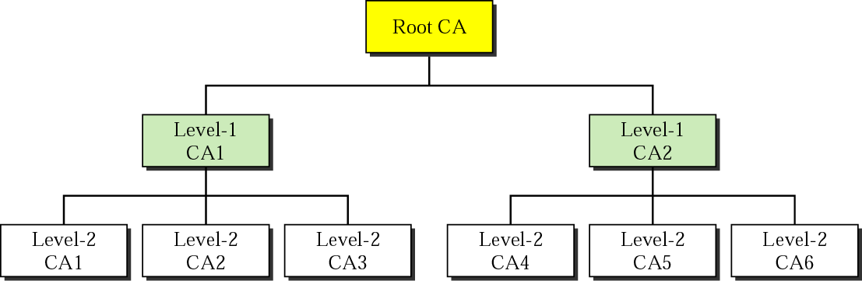
Figure 28.24 PKI hierarchy

Slide 44
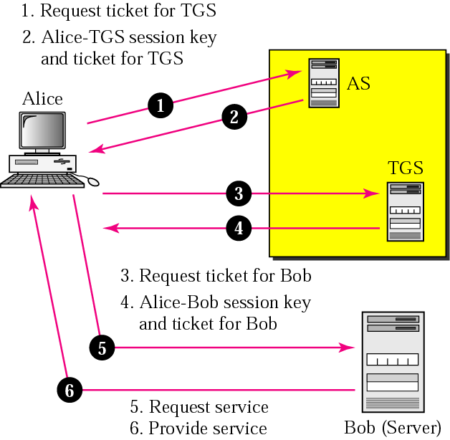
Figure 28.25 Kerberos servers

Slide 45
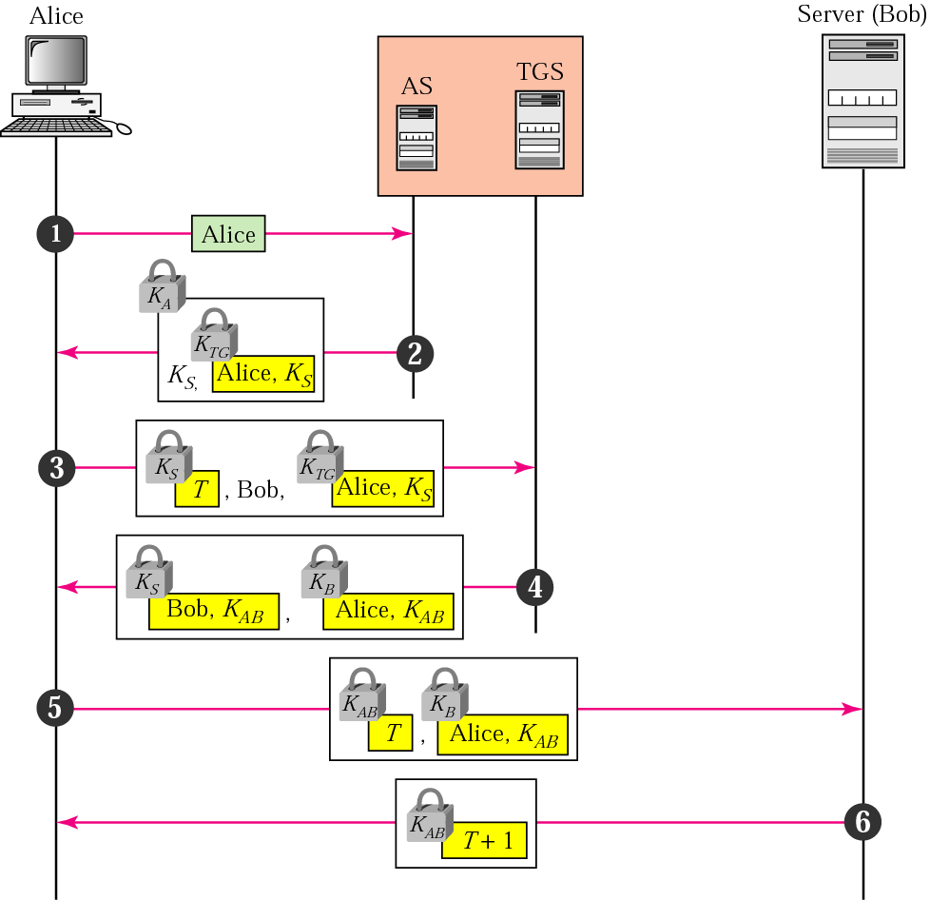
Figure 28.26 Kerberos example

Slide 46
28.6 SECURITY IN THE INTERNET
In this section we discuss a security method for each of the top 3 layers of the Internet model. At the IP level we discuss a protocol called IPSec; at the transport layer we discuss a protocol that “glues” a new layer to the transport layer; at the application layer we discuss a security method called PGP.
The topics discussed in this section include:
IP Level Security: IPSec
Transport Layer Security
Application Layer Security: PGP

Slide 47
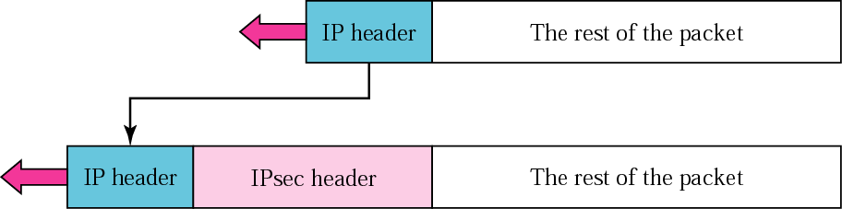
Figure 28.27 Transport mode

Slide 48
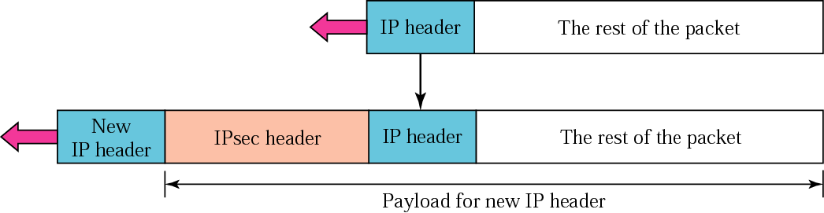
Figure 28.28 Tunnel mode

Slide 49
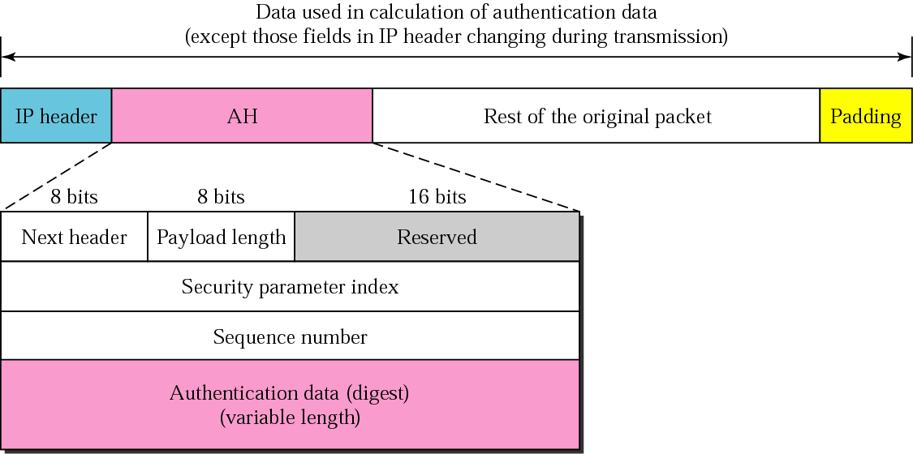
Figure 28.29 AH

Slide 50
Note:
The AH protocol provides message authentication and integrity,
but not privacy.

Slide 51
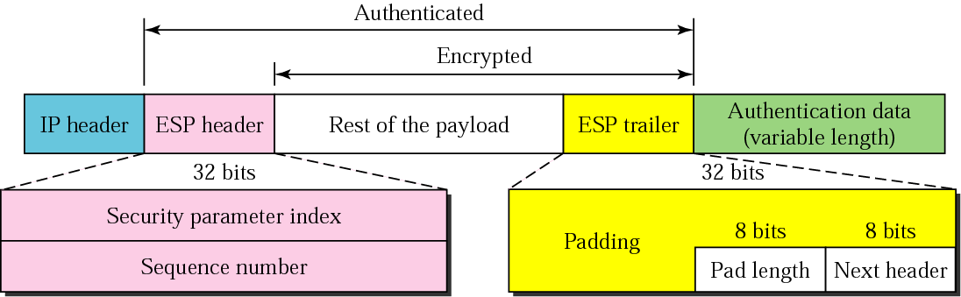
Figure 28.30 ESP

Slide 52
Note:
ESP provides message authentication, integrity, and privacy.

Slide 53
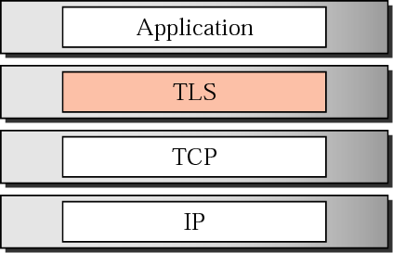
Figure 28.31 Position of TLS

Slide 54
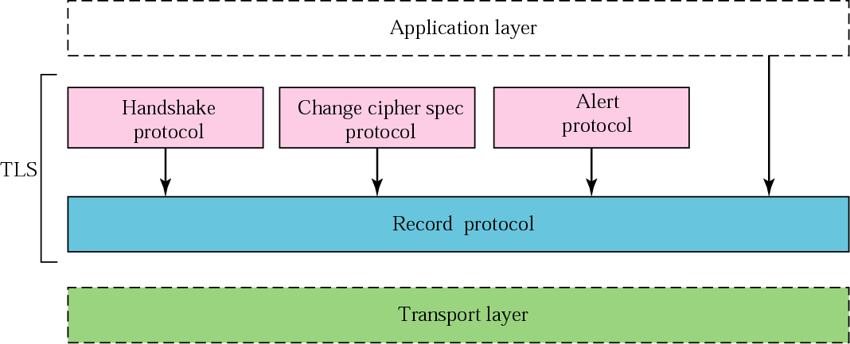
Figure 28.32 TLS layers

Slide 55
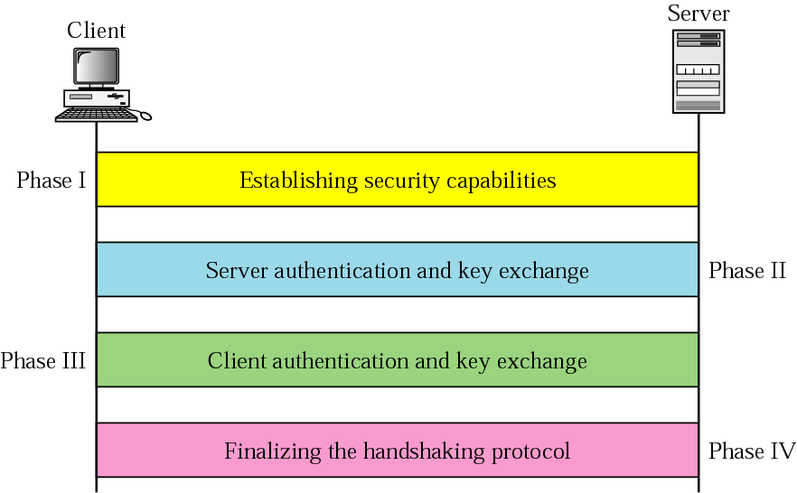
Figure 28.33 Handshake protocol

Slide 56
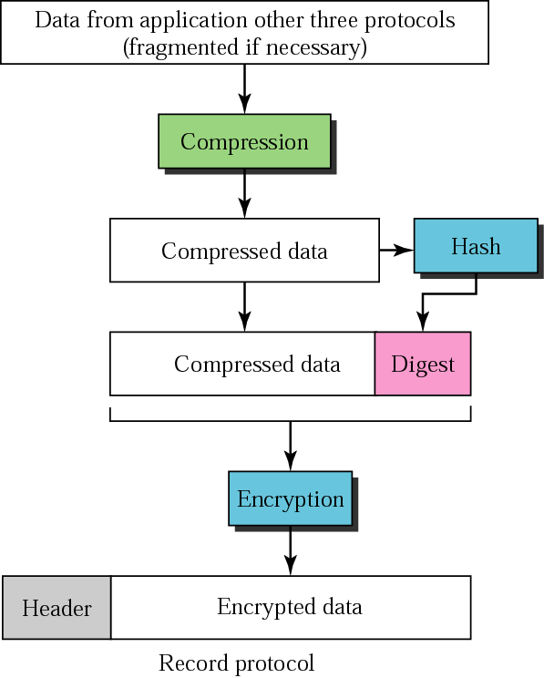
Figure 28.34 Record Protocol

Slide 57
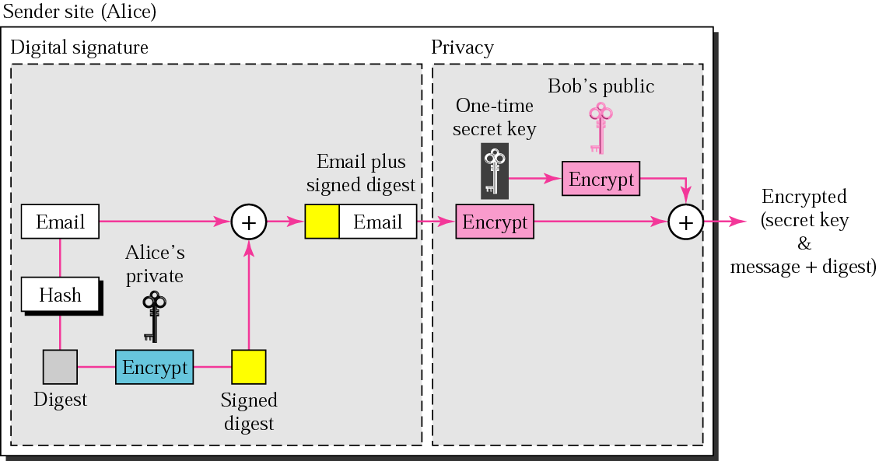
Figure 28.35 PGP at the sender site

Slide 58
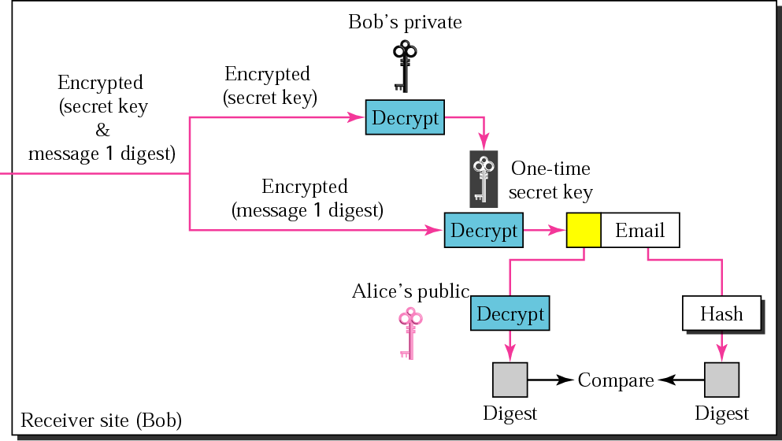
Figure 28.36 PGP at the receiver site

Slide 59
28.7 FIREWALLS
A firewall is a device (usually a router or a computer) installed between the internal network of an organization and the rest of the Internet. It is designed to forward some packets and filter (not forward) others.
The topics discussed in this section include:
Packet-Filter Firewall
Proxy Firewall

Slide 60
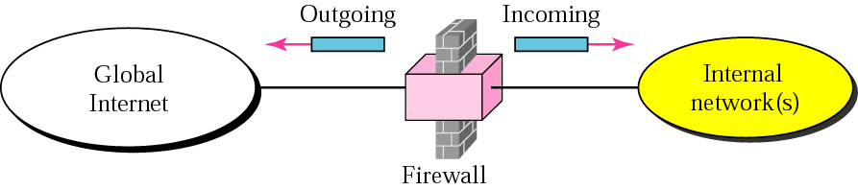
Figure 28.37 Firewall

Slide 61
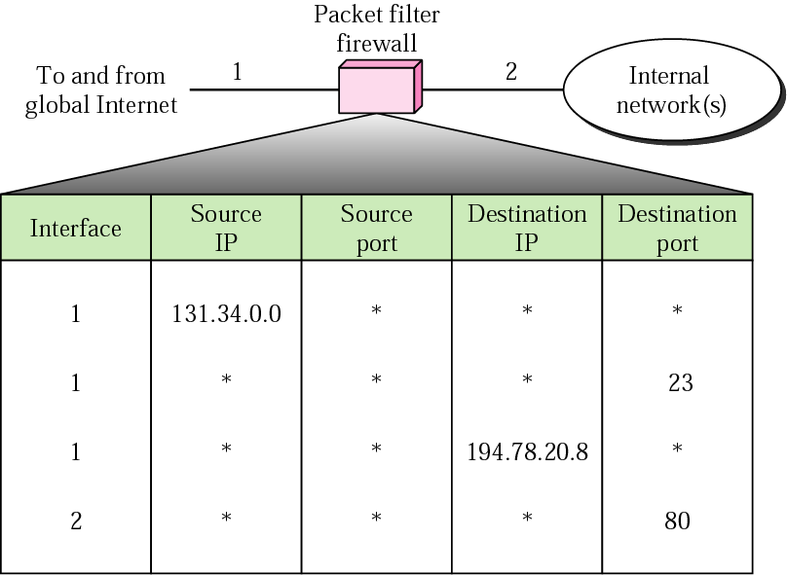
Figure 28.38 Packet-filter firewall

Slide 62
Note:
A packet-filter firewall filters at the network or transport layer.

Slide 63
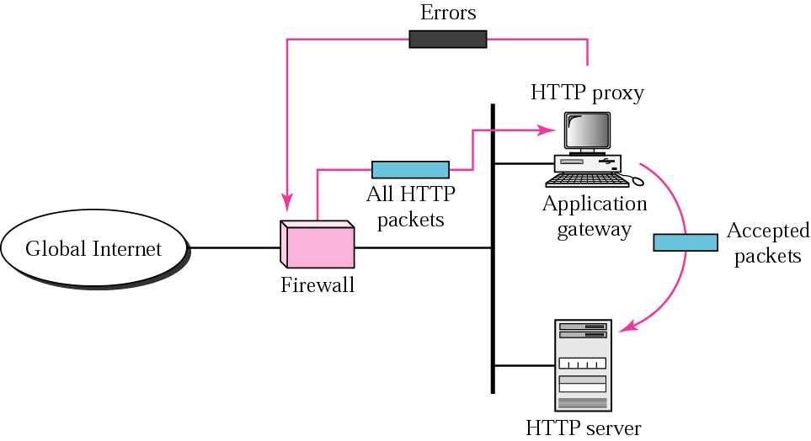
Figure 28.39 Proxy firewall

Slide 64
Note:
A proxy firewall filters at the application layer.

